Slide 1
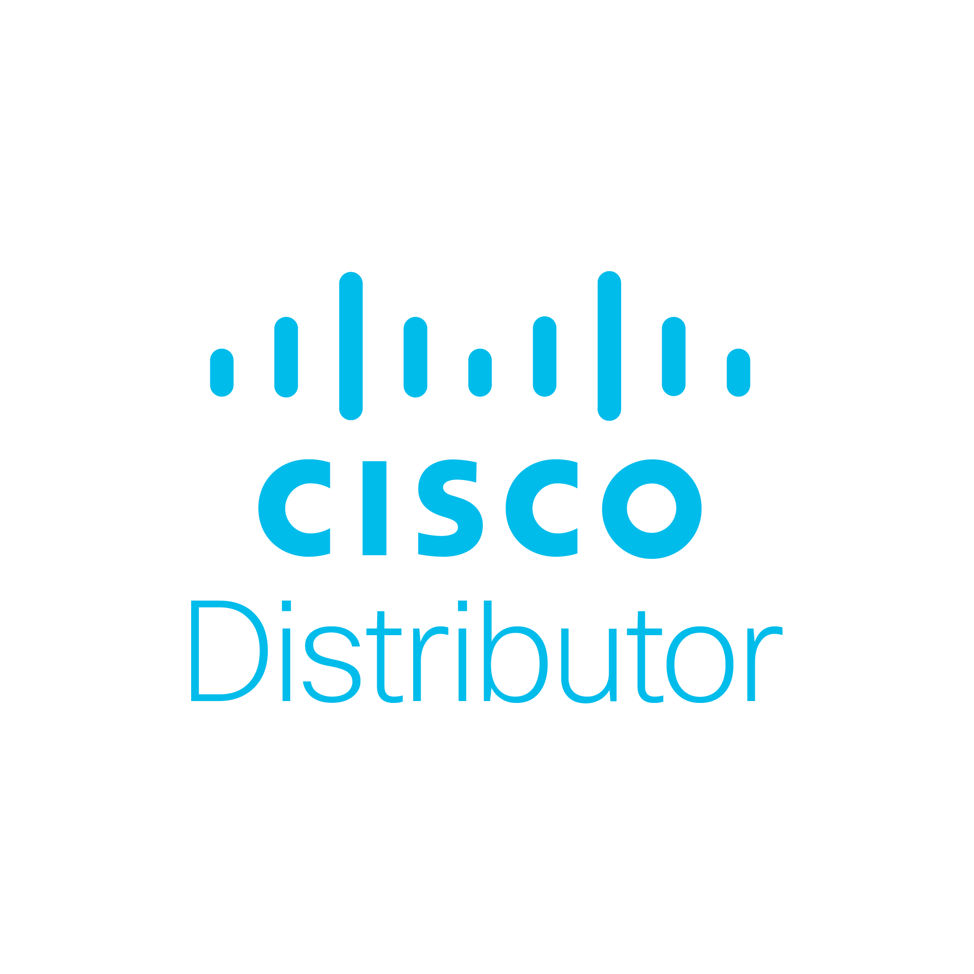
Comstor helps partners renew opportunities better than anyone else
Notes:
According to #Cisco, renewals make up 33% of your revenue. Grow your revenue base with the help from our #renewals experts at Comstor and maximise every opportunity. Find out more:

Slide 2
Ensuring cash flow is key for business continuity, and every renewal is an opportunity for incremental revenue and growth
Notes:
According to #Cisco, renewals make up 33% of your revenue. Grow your revenue base with the help from our #renewals experts at Comstor and maximise every opportunity. Find out more:

Slide 3
It’s essential to shift focus from acquiring new customers to protecting and expanding your existing customer base
Notes:
By retaining just 5% of your customers, you can increase your profits by up to 75%. Focus on #renewals and win with our team of experts at #Comstor. Find out more:

Slide 4
Renewals will protect and expand your existing customer base
Notes:
The chances of selling to an existing customer are 70% compared with 10% for a new prospect. Secure those #renewals and discover new opportunities for expansion with the help from our expert renewals team at #Comstor. Find out more:

Slide 5
Measure and track what success looks like with our Comstor experts in renewals
Notes:
By setting clear goals and objectives, you’re far more likely to increase your renewal rate and uncover new expansion opportunities. Get support from our expert team of renewal experts at #Comstor and map your path to success. Find out more:

Slide 6
Maximise services renewals and expand the opportunity with our Comstor experts
Notes:
Make your services #renewals easier with a step-by-step approach and expert guidance from our renewals team at #Comstor. Secure your renewals and expand your recurring revenue. Find out more:

