Slide 1


Cisco Services Playbook
Grow revenue and increase profitability with Cisco services

Slide 2

About this playbook
Comstor adds significant value to world of Cisco Services.
Click on the headers below to go directly to that section.
Cisco Services Portfolio
Why invest in Cisco Services
Why Cisco Support Services
Why buy from Comstor
Increase value with Cisco
Why Smart Net Total Care
SNTC features and coverage
Solution Support service features
Why Solution Support is important for your Customer
Cisco Software Support
Software Support Service Levels
Cisco services portfolio comparison
Solution Support or Software Support
Renew with Comstor
Helping our Partners
Renewals: Maximising the opportunity
5 reasons to renew with Comstor
Comstor Partner facing tools
What is PartnerCentral?
4 steps to more revenue
Maximizing the business outcomes
How to maximise business outcomes
Partner Experience Platform (PXP)
Cisco Ready for Partners
Comstor Icebreaker Program
Lifecycle Advantage
Smart Net Total Care Portal
Enhancing profitability with Cisco Services
Multiyear services offer you the best deal
Cisco Services Partner Program – Europe
Cisco Services Partner Program - MEA
Available Service Promotions
Handling your Customers objections
Partners testimonials
2

Slide 3


The Cisco Services portfolio
Back to Contents
3

Slide 4


As IT ecosystems become multi-product and multi-vendor, customers face new challenges
Services portfolio
Renew with Comstor
Maximising business outcomes
Enhancing profitability
Why invest in Cisco Services?
Business continuity is at risk from changing technological and business requirements. Customers are asking how they can:
Resolve problems quickly to minimise downtime, and prevent issues
Increase network utilisation, extend the life of IT, and extract more value
Improve staff knowledge and operational processes, and unburden overextended operation resources
Deliver new capabilities quickly and efficiently or make changes to existing services with minimum disruption
69%
IT Leaders think technology has become more complex. Too complex to manage every aspect in house¹
93%
IT Leaders face a skills gap that is hard to close as technology evolution outpaces capacity for continual training²
46%
New revenue growth in IT is attributed to emerging technologies during 2018-2023¹
Back to Contents
Source 1: CompTIA 2020 Industry Outlook
Source 2: IDG report
4
Notes:
So while multiproduct, multivendor solutions are the new norm, they can present challenges:
A recent CIO study showed that 69% of IT leaders think technology in general is getting more and more complex, too complex to successfully manage in house.
Especially when you consider a majority of IT leaders believe they are facing a skills gap, one that’s hard to close as technology evolution outpaces capacity to continually train and help build IT team knowledge and skills.
Today’s rapidly changing technological and business requirements are putting customer’s business continuity at risk.
The questions they are asking are how they can:
Resolve problems quickly to minimize downtime, and proactively prevent issues?
Increase network utilization, extend the life of IT infrastructure, and extract more value?
Improve staff knowledge and operational processes on a continuous basis, and unburden my already overextended operation resources?
Deliver new capabilities quickly and efficiently or make changes to existing services with minimum disruption?

Slide 5






Services portfolio
Renew with Comstor
Maximising business outcomes
Enhancing profitability
Cisco Services portfolio
Benefits of Support Services
Shift to a recurring revenue model
Smart Net Total Care
Ensure business continuity
Solution Support
Boost profits / margins
Software Support
Increase ROI / reduce TCO
Access to Cisco’s toolsets
50%
of partner
revenue
56%
of partner
profits
Improve customer retention
Back to Contents
5
Notes:
There are different support offers available depending on the customer’s needs, extending your customer interaction beyond a product sale relationship by providing comprehensive, strategic and innovative solutions which can position you to play a greater role in your customers’ success. From a profitability perspective, selling services offers the opportunity to earn higher margins generating a recurring revenue stream through the sale of services renewals and achieve rebates via the CSPP partner program.
In a nutshell, Cisco Services helps you to:
Shift to a recurring revenue business model - Cisco services allow you to start building predictable revenue streams, renewable on a yearly or term basis.
Services protect your customers network investments improving customer satisfaction and loyalty by helping your customers successfully operate and optimise Cisco technologies throughout the lifecycle of their network.
Maintain business continuity – the financial impact of being without business-critical applications can be huge. It minimizes the impact of network downtime and speeds the time to resolution.
Maximize Return on investment – It extends the productive life of the technology by adding new functionality while reducing the Total Cost of Ownership.
Increase revenues and Margins – Services not only allows to expand the revenue of a deal, but also to drive incremental margins, not just front-end but also in the way of back end financial rewards. It also allows reduce your operating and logistic costs.
Overall, Cisco Services provide you with the tools you need to play a key role into your customers success, while helping you build predictable revenue streams

Slide 6
Services portfolio
Renew with Comstor
Maximising business outcomes
Enhancing profitability
Why buy from Comstor?
Partner enablement
Focused on partner growth
Service practice builders
Dedicated
teams
Services portfolio advisors
Access to dedicated teams
Partner
enablement
Digital customer tools & platforms
Dedicated
teams
Lifecycle
management
Business outcomes
Upsell/cross sell/refresh
Increased
profitability
Driving margin and revenues
Maximizing rebate potential
Cisco Services
with Comstor
Renewals
experts
Dedicated teams
Opportunity management
Renewals
experts
Lifecycle
management
Digital tools and platforms
Partner self-serve
Unlock revenues opportunities
Increased
profitability
Back to Contents

Slide 7
Services portfolio
Renew with Comstor
Maximising business outcomes
Enhancing profitability
Increase value with Cisco
Software Support Premium²
Software Support Premium
(Collaboration)
(Security)
Incremental value
Software Support Enhanced²
Software Support Enhanced
(Collaboration)
(Security)
Solution Support¹
Addresses both hardware and software in solution environments
Smart Net Total Care (SNTC)
Software Support Basic (SWSS)
(flexible RMA options available)
Hardware offers
Software offers
1. Purchase of Solution Support includes SNTC or SWSS
2. Purchase of Software Support for Collaboration, Enhanced and Premium levels, includes Solution Support
Back to Contents
7

Slide 8

Services portfolio
Renew with Comstor
Maximising business outcomes
Enhancing profitability
Why Smart Net Total Care?
SNTC Service Features
SNTC offers Cisco product support to help customers get the most out of their Cisco investments, plus smart capabilities that extend the value even further
65% reduced security breach risk
Advance HW replacement
Security and product alerts
75% reduction of outages
Access to Cisco TAC
OS SW updates
Lifecycle control
Install base visibility
120%
ROI over
3 years
Back to Contents
8
Notes:
As per the Forrester Total Economic Impact Study of 2017, Smart Net Total Care allows to reduce the risk of security breaches in 5%, reduce the time to fix to one fourth and achieve an ROI over 3years of 120%.
with a service contract you get expert support from Cisco TAC engineers, replacement parts in as little as 2 hours, OS updates and upgrades, access to Cisco’s knowledgebase and entitlement to smart capabilities. In the event of an incident or network downtime, all of these can help you get the issue resolved as fast as possible. So, we can say that Cisco Services are not just a nice to have add-on to a Cisco Solution but a key element to maximize the business outcomes your customer is looking for.
Cisco Smart Net Total Care gives the opportunity to engage your customers in new ways and position your company as a trusted advisor. It has been integrated with smart capabilities designed to address next-generation support requirements.
Smart capabilities help customers reduce operating costs, resolve incidents faster, and mitigate risk. This result in increased service levels and an infrastructure that is more agile and responsive to changing IT needs.
By adopting the smart capabilities, customers can have an up-to-date view of the Cisco equipment installed in their infrastructure as well as a comprehensive view of all their support contracts, including which equipment is covered and what is not covered. Smart capabilities include inventory and contract management features, device diagnostics, and relevant alerts for Cisco products. Smart Net Total Care also shows only the product and security alerts that are relevant to the customer's network, saving time and enabling them to focus on those that are critical.

Slide 9
Services portfolio
Renew with Comstor
Maximising business outcomes
Enhancing profitability
SNTC features and coverage
Cisco Smart Net Total Care Features – Device Level Coverage
Suitable for any size of business, with any number of Cisco devices
Technical Assistance Centre (TAC)
Advance Hardware Replacement
Operating System Software Updates
Online Self-help
Resources
Smart Capabilities Entitlement
Access to highly-trained TAC network and application software engineers worldwide. Available 24x7x365 in multiple languages
Access via the web,
e-mail or telephone
Broad expertise in Cisco technologies
Rapid fault isolation in a complex environment leading to accurate resolution
Flexible hardware replacement options:
  2-hour
  4-Hour
  Next Calendar Day
  Next Business day
Wide geographic coverage: 191 countries served via 1400 depots in 137 countries
More tan 3,000 field engineers with an average field experience of more than 5 years
Increase performance of SW
Add new functionality, often without additional hardware investment
Enhance availability and stability of your network and business applications
Extend the life of your Cisco products
Automated troubleshooting tools
Personalized content and solutions
Global support community
Open and track service requests online
Information on certification training
Access to extensive technical knowledge library
Security and product alerts (actionable security alerts, relevant product notices, service availability alerts)
Service coverage management (covered/uncovered products, renewal preparation and planning, budget planning)
Product lifecycle management (up to date IB information, EOX, SW version mismatches, automation to reduce costs and risks)
Back to Contents
9

Slide 10
Award winning technical support
Prioritized case handling
Primary point of contact
Pro-active approach
Open door policy
Deep solution expertise
Services portfolio
Renew with Comstor
Maximising business outcomes
Enhancing profitability
Solution Support
service features
Why buy Cisco Software Support
Centralized support for Cisco hardware, software and third-party partner solutions from first call to resolution
Award winning technical support
Prioritized case handling
44% decrease in time to resolution
Primary point
of contact
Pro-active approach
32% Increase in IT staff efficiency
Open door policy*
Deep solution expertise
213% ROI over 5 years
*No need to spend time and resources diagnosing a problem before contacting Cisco’s architecture experts
Back to Contents
10
Notes:
Cisco Solution Support provides centralized support for Cisco hardware, software and third-party partner solutions from first call to resolution. It is a services is part of the Cisco High-Value Services. It differs from Smart Net Total Care that support is not provided only a device level; it provides support at a solution level.
Cisco Solution Support is the right kind of service for solution environments because it offers a differentiated customer experience through:
Primary point of contact: Cisco solution experts are accountable for resolving your issue no matter where it resides. You receive continuity of service from first call until you close your case.
Solution expertise: Cisco’s deep knowledge about how the solution works as a whole means they can often resolve issues immediately, helping you get back to business sooner.
Fast response and resolution: Priority service levels connect you to solution experts who resolve complex issues on average 43 percent more quickly than product support alone.
Product support team coordination: Seamless collaboration with the Cisco TAC and strong relationships with solution partners, Cisco effectively manage support to best resolve your issue.
Open door policy: Initiate a case even if you’re not sure you have an issue. There’s no need to diagnose or isolate your problem before contacting our solution experts.
Proactive approach: Cisco experts look beyond the scope of your case to identify potential known issues and provide recommendations to course correct, helping minimize or eliminate issues before they can disrupt IT and the business.
Broad availability: Eligible for products in the Collaboration, Data Center, IoT, Networking or Security portfolios, giving you the flexibility to define your solution and get the right kind of support for it.
One service, deep coverage: You get both solution-level support and Cisco product support in one service that’s easy to order and renew.
Retain direct contact with Solution Support Partners >> If you have isolated your issue to a partner’s product, you have the flexibility to contact them directly for their product support.
Reliable cost of expansion >> Available on services price list and ordering tools for predictable costs on new deployments or expansions.
Positioning Cisco Solution Support has several advantages, including:
Increasing services deals and recurring revenues, while moving toward premium rebates.
Offering the right kind of support for solution purchases without needing to invest in building your own service
Protect you account teams from post-sale support flare-ups
Finally increased customer satisfaction and propensity to buy due to faster resolution times on complex cases

Slide 11

Services portfolio
Renew with Comstor
Maximising business outcomes
Enhancing profitability
Cisco Software Support
In the growing software sales landscape, Software Support provides fast response times and direct access to software experts to help with your technical adoption plan.
Enhanced and Premium service levels are the best fit for software environments; obtain a seamless support experience across on-premises, cloud and hosted software deployments.
Premium
Enhanced
Enhanced plus
Basic plus
Basic
Highest priority case handling
Designated expert with specialized knowledge
Support case analytics
Escalation management
Software technical support
Software updates
Knowledge-base and online resources
Prioritized case handling
Technical onboarding and adoption
Learning and training recommendations
Back to Contents
11
Notes:
The next high value service offer is dedicated to software. Software sales are increasingly growing and if it is just a software version upgrade or a requirement for integration, Software Support is the offer to go for. Because it provides with fast response times, direct access to Cisco software subject matter experts, help with a technical adoption plan.
Software Support allows you to choose the support level that is right for your business needs. There are 3 Levels that include:
Basic – This is the SWSS we all know, that provides minor and major SW updates.
Enhanced – Includes all Basic-level features plus prioritized case handling, direct access to highly skilled Cisco engineers with solution level expertise, onboarding and technical adoption assistance and periodic configuration reviews.
Premium – Includes all Enhanced-level features plus designated service management, including a Cisco expert who knows your IT environment, provides proactive support. As your business evolves and you deploy software on-premises, in the cloud, or hosted by third parties, this offer can help you every step of the way.
In summary, the Enhanced and Premium service levels are especially beneficial if you need faster deployment of your software, a seamless support experience across on premise, cloud and hosted deployments that lead to a faster.

Slide 12
Services portfolio
Renew with Comstor
Maximising business outcomes
Enhancing profitability
Software Support Service Levels
Service Level
Code
TAC
Access
TAC Response Time
Minor Software Releases
Major Software Releases
Proactive Software Support
Technical Adoption
Prescriptive Software Support
Designated Service Manager
Advanced Technical Adoption
SAS
24x7
60 min
Software Support Basic*
24x7
60 min
Software Support Enhanced**
24x7
30 min*
Software Support Premium**
24x7
15 min**
*Included within the subscription software
**Prioritised case handling over previous tier
Back to Contents
12

Slide 13
Services portfolio
Renew with Comstor
Maximising business outcomes
Enhancing profitability
Cisco Services portfolio comparison
Smart Net Total Care and Software Support Basic is included in the purchase of Solution Support. You retain their service features plus get features purpose-built for multiproduct, multivendor issues in a solution ecosystem.
Smart Net
Total Care®
Software
Support Basic
Solution
Support
Basics | 24x7 access to award-winning TAC
 | Advance hardware replacement (with service level options) + OS updates
Priority | Service response objective for high severity cases | 60 minutes | 60 minutes | 30 minutes
 | Prioritized case handling
 | No triage required to open a case
Expertise | Architecture expertise (Cisco and Solution Support Alliance Partner hardware and software)
 | Broad solution view to identify any known issues beyond original case scope and addressing
Efficiency | Primary point of contact centralizing support across a solution deployment
 | Product support team coordination (Cisco and Solution Support Alliance Partners)
 | Accountability for multiproduct, multivendor case management to resolution
 | Virtual Spaces on Webex Teams instant messaging contact preference for low severity cases
Back to Contents
Notes:
Some of you may have or know about Cisco product support; we get a lot of questions about how solution-level and product-level support compare. We covered that a bit when we discussed Solution Support features focused on prioritizing your case. Let’s walk through a side by side comparison now.
>> BASICS
One thing to point out is that when you purchase Solution Support for your hardware, it includes underlying Smart Net Total Care OR Software Support Basic. So you can see under “Basic” features, there is parity. From there, Solution Support is significantly different, and offers higher-value features.
>> PRIORITY
SLO for S1/S2 cases
There are several high level features from Solution Support that will be critical for your deployment that we will cover, but we know speed is the #1 priority when getting any issue fixed, so we will cover these first when talking about the differences between SNTC and Solution Support. Here, Solution Support engineers will respond to your request in 30 minutes or less so we get issue isolation and resolution processes underway as quickly as possible.
Prioritized case handling
When a product support and Solution Support case of the same severity are assigned to an engineer, the Solution Support case receives top priority.
No triage required to open a case
This eliminates your need to spend time isolating an issue to a specific product before contacting us for help, and
Expedites connection to a solution expert for issue resolution or if you need guidance, information, etc.
>> EXPERTISE
Deep architecture expertise
Your Solution Support engineer is expert in Cisco hardware and software products and their integration with Solution Support Alliance Partner products within and across our technology architectures.
This level of knowledge often results in immediate resolution of solution- or product-level issues.
Broad solution view
Because Solution Support is focused beyond individual products and address the entire deployment as a whole, they broaden their scope and can look beyond your original case for areas to optimize, or scout for known issues to course correct, or, if they’ve developed into an issue, help get it resolved.
This broad view can help prevent an issue from occurring, or from getting worse if it’s already become a problem, helping you further minimize IT and business disruption.
>> EFFICIENCY
Primary point of contact
Here, Solution Support engineer architecture experts centralizes support across a multivendor or multiproduct deployment, which
Eliminates your need to spend time identifying which provider to call, and gets you connected to the right resources to issue resolution underway.
Product support team coordination
This is another huge time saver for you. Solution Support engineers orchestrate Cisco and Solution Support Alliance Partner product support teams throughout issue resolution, bringing a solution-level perspective to the discussions so that solving one issue does not create another one.
This eliminates your need to manage complex issues and multiple support teams, while Solution Support helps maintain interoperability within your deployment.
Manages case to resolution
While of course Solution Support is accountable for helping you resolve issues you raise with us, here it takes on an increased level of importance if your issue involves multiple support teams, none of whom are accountable for the solution as a whole. Your Solution Support engineer actively manages your case from first call to resolution, ensuring the process flows efficiently. This is especially critical when working with multiple product support teams.
This accountability results in support continuity and a streamlined experience for you and your IT teams.

Slide 14
Services portfolio
Renew with Comstor
Maximising business outcomes
Enhancing profitability
Solution Support or Software Support?
What is the right offer?
Solution Support
Software Support
Partner Type
Partner Type
End-user needs
from Partner
End-user needs
from Partner
Partners who currently do not have their own support services practice
Partners who do have their own support services practice, but don’t have the resources to support multi-vendor environments
Are effective at selling complex and converged solutions in Data Centre, Enterprise Networking, and Security
Are looking for levers for increasing recurring revenue and Cisco rebate sizes
Direct access to solution manufacturer support
Primary point of contact for complex, converged, and/or multi-vendor solutions
Faster response and resolution time than foundational support
A service that extends their IT bench as new technology drives business outcomes
Partners who currently do not have their own support services practice
Partners who do have their own support services practice, but for Collaboration and/or Security architecture(s) do not yet have capabilities built for:
  Software configuration reviews
  Product deployment guidance
  Feature adoption planning
  Migration assistance and guidance
  Support for software integration
Industry expert
Looking for solution experience
Management of onboarding process and enablement for software purchased as well as any additional configuration work required
Local presence with global footprint
Planning > Integration > Implementation > Support
Back to Contents
14

Slide 15
Renew with Comstor
Back to Contents
15

Slide 16

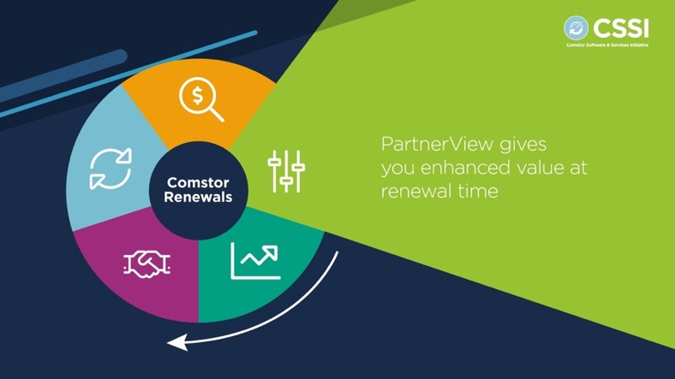
Helping partners at renewal time
Services portfolio
Renew with Comstor
Maximising business outcomes
Enhancing profitability
Renewals in numbers
The most common reason customers don’t renew their Cisco contracts is because they did not know it was available.
With Comstor, you can engage every customer quickly. We notify you about every opportunity in time so you don’t miss any deal.
33% Partner revenue
Renewals represent 33% of partner revenue
75% increased profits
By retaining 5% of customers
Watch our video:
60%
incremental sales
https://westconcomstor.wistia.com/medias/vwx19rytw4
The chance of selling to an existing customer vs a new prospect
Back to Contents
16
Notes:
Video in Wistia:
German - https://westconcomstor.wistia.com/medias/sxqldn7j5r
French – https://westconcomstor.wistia.com/medias/p1yjc44j0r
Spanish - https://westconcomstor.wistia.com/medias/615qtno96a

Slide 17

Services portfolio
Renew with Comstor
Maximising business outcomes
Enhancing profitability
Renewals: maximising the
opportunity
Why is that important?
Are you…?
  Reactive?
  Your customer contacts
  you when a renewal is
  coming up
  Informed?
  You have organised
  your customers and data,
  and you are quoting your customers 90 days before
  the renewal is due
Revenue expansion rates dramatically improve
117%
99%
102%
106%
22%
13%
13%
16%
  Proactive?
  You are using data to drive a programmatic approach: you not only look at renewals but also at tech refresh and upsell
  Predictive?
  You have optimised the lifecycle across all functions and you are leveraging automation to drive scale and maximise visibility
86%
89%
89%
95%
Reactive
Informed
Proactive
Predictive
Average Gross Retention %
Average Expansion
Rate %
Average Net
Retention %
Gainsight Customer Success Index Survey
Back to Contents
17
Notes:
The renewals business has evolved during the last years, and it is no longer matter of renewing an existing contract; the renewals time is the moment to start delivering Customer Success, start having lifecycle conversations.
Renewals is a key element, not just for starting lifecycle conversations, but also to increase your profitability.
Some facts on renewals are:
It takes five times more effort to gain new customers than doing business with current ones
The chances of selling to an existing customer are 70% compared with 10% for a new prospect
Customers are four times more likely to go to a competitor if they encounter service-related problems compared with price or product-related problems
Having said this, we need to analyse what is our approach towards renewals. Are we reactive, informed, proactive or predictive. Understanding in which stage we are will help maximize the renewals opportunity.
As per the chart you are seeing shows a clear link between operational maturity and net retention performance.
Net retention performance steadily increases as operational processes improve.
Negative Churn is achieved for companies at the Informed Stage and beyond
Both gross retention & expansion rates improve at the Proactive Stage
Companies in the Predictive Stage are expanding customers at a best-in-class expansion rate.
If we want to increase customer retention and maximize the renewals opportunity, we need to efficiently manage the data and automate it, become data-driven, and Comstor can help you with this.

Slide 18
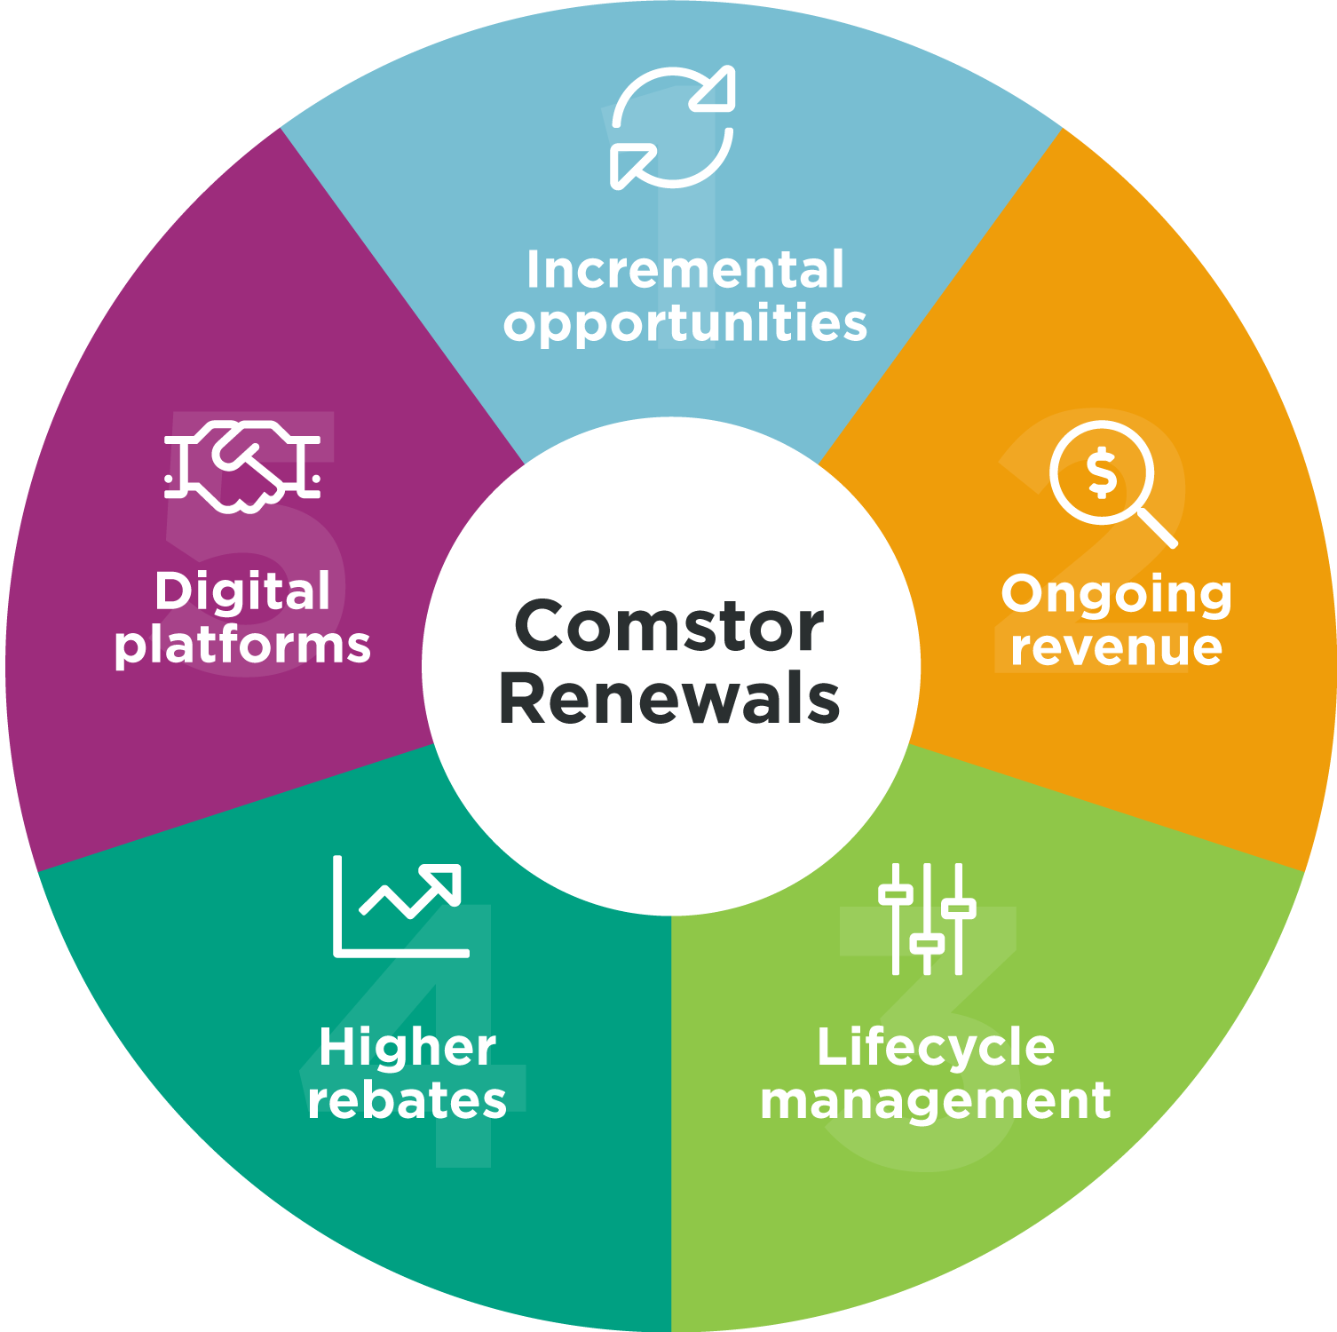
Services portfolio
Renew with Comstor
Maximising business outcomes
Enhancing profitability
5 reasons to renew with Comstor
We only sell Cisco and we know their renewals journey inside out
Incremental opportunities from your real data
Our integration with Cisco’s TPV database opens more up- and cross-sell business opportunities at renewal time by proposing new solutions that add value. TPV consolidates data from multiple sources for a single view of partner programmes.
5. Digital platforms and tools
for easy online transactions
Our powerful, user-friendly partner platforms make working with Comstor easy. Transact and manage your Cisco portfolio where and when you want on PartnerView.
2. Simple steps to on-going revenue
Our on-time renewal notifications are easy to understand and action, with simple steps to complete so you don’t miss any opportunity. We offer advice on contract consolidation and co-terms to help reduce admin time and cost.
4. Higher rebates and help to
get them
Attach or renew multi-year services or Cisco Capital – we know what the key rebates are and we will help you grab them.
3. Lifecycle management with a Comstor CX-certified team
Our Cisco-certified expertise in lifecycle management helps you grow in this strategic priority for Cisco. We identify obsolete solutions and provide migration opportunities to achieve better business outcomes for your customers.
Back to Contents
18

Slide 19

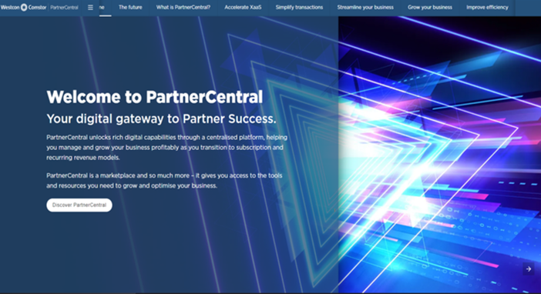
Comstor partner tools
Services portfolio
Renew with Comstor
Maximising business outcomes
Enhancing profitability
Partner applications for every business need
Access via our Partner Portal or www.westconcomstor.com
PartnerCentral
Our e-commerce platform to access and download your Cisco renewal opportunity and purchase and renew SaaS products
There are other tools you might be interested in to search for Partner facing assets, promotions, tools, videos, demos, training, etc.
Partner Portal can be accessed on here
Register to access the Partner Portal
Back to Contents
19

Slide 20

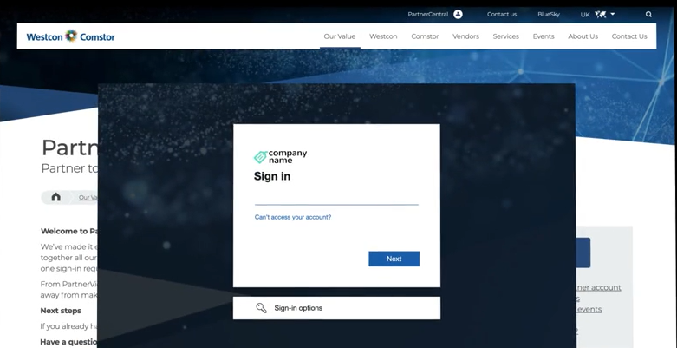
How PartnerCentral will help you renew?
Services portfolio
Renew with Comstor
Maximising business outcomes
Enhancing profitability
Our e-commerce platform to shop online and manage orders
  Search, download, review and purchase Cisco renewals contracts with Comstor online
  Simple purchasing and procurement
  Visibility of all quotes, orders and renewal opportunities at SKU detail
  Discounts automatically applied (country specifics)
  View licenses
  Quick access to PDF’s – invoices / packing slip / order acknowledgement
  Request RMAs
  Integration with vendor systems allows migration of existing quotes
  Find out more about PartnerCentral
Back to Contents
20
Notes:
Add link to Wistia Video

Slide 21
Services portfolio
Renew with Comstor
Maximising business outcomes
Enhancing profitability
4 steps to more renewal's revenue
Kick start your digital lifecycle practice, enhance cash flow, increase margins, and retain customers
1
Set up notifications
Select your preferences in the profile section of our e-commerce PartnerView so you receive auto-notifications on new and available renewal opportunities available
2
Download quotes
Simply download our quotes and start the renewal conversation with your customers at least 90 days before service contract expiration; we recommend you default your renewals to three years
3
Talk to us
Talk to your Comstor service renewal expert to identify more opportunities such as co-term/consolidation or product refresh
4
PXP engagement with Comstor
For a strategic long term improvement, start a ‘DPV’ relationship with us to get a personalised analysis and recommendations to boost your revenue
Start increasing your profitability, see how your costs get reduced and increase efficiency with Comstor expertise in renewals.
Back to Contents
21

Slide 22
Maximising business outcomes
Back to Contents
22

Slide 23
Services portfolio
Renew with Comstor
Maximising business outcomes
Enhancing profitability
How to maximise business outcomes and tools
Lifecycle management
Renewals
Lifecycle management provides a reason to interact with customers with greater frequency for upselling, cross-selling, and growing an existing customer relationship, while identifying opportunities for achieving enhanced outcomes.
Smart Net Total Care Portal
Partner Experience Platform (PXP)
CX
Smart IB
Cisco
Ready
Renewal
Renewal is the best moment to deliver lifecycle management and with Cisco and Comstor you gain the visibility needed to reach your customers desired business outcomes while increasing your profitability.
Lifecycle Advantage
Back to Contents
23
Notes:
Having visibility of the customer network for driving those lifecycle conversations I was just talking about is not easy;L but we have tools available to help us drive those business outcomes. Today I will talk about 4 of them, Total Partner View, Icebreaker, LCA and Cisco ready.
TPV gives you visibility of your rebate eligible opportunities so you can maximize your CSPP performance. Through this tool, you will see what you sold and from that what is covered, what a is due for renewal and what is rebate eligible and what not. Through a C2V relationship we can help you identify those opportunities, identify up-sell and cross-sell opportunities. Also, you can follow on your past and pending rebate payments.
Icebreaker – before describing IB, I want to show you a video that easily describes all the value you can get from it.
Through Icebreaker, as we have just seen, you can get a full picture of all your past sales, so you can have a lifecycle approach with your end user. Through this report we can help you identify what is covered or not, all your future renewals but most importantly what are the technology refresh opportunities.
The information can be taken to the next level upon requesting an end user Icebreaker report, where you will see all the install base of the end customer to allow you enhance those lifecycle conversations.
LCA – Lifecycle Advantage platform allows to digitally engage with your customers through co-brandable communications. There are several tracks to focus on, such as:
Growth track – For addressing 2nd chance attach and/or tech refresh opportunities on devices reaching LDoS.
Success Tracks – To help with learning, implementation and adoption plays.
Renew track – to help address those upcoming renewal opportunities.
CISCO READY - Cisco Ready is the stop shop to understand and true up your customer’s Install Base, and prospect relevant Sales Opportunities. Save time by running your own reports and finding data that translates into real sales opportunities.
This tool will help prospect relevant Sales Opportunities, including: Subscription, Service Renewal, Service Attach and Product Refresh
With Cisco Ready you get:
View your customer(s) Cisco assets including perpetual software, subscription and hardware
Run customized ad-hoc analysis and reports
Display focused installed base data including Collaboration Refresh, Flip2Flex, Modernize Wireless and Data Center Refresh.

Slide 24
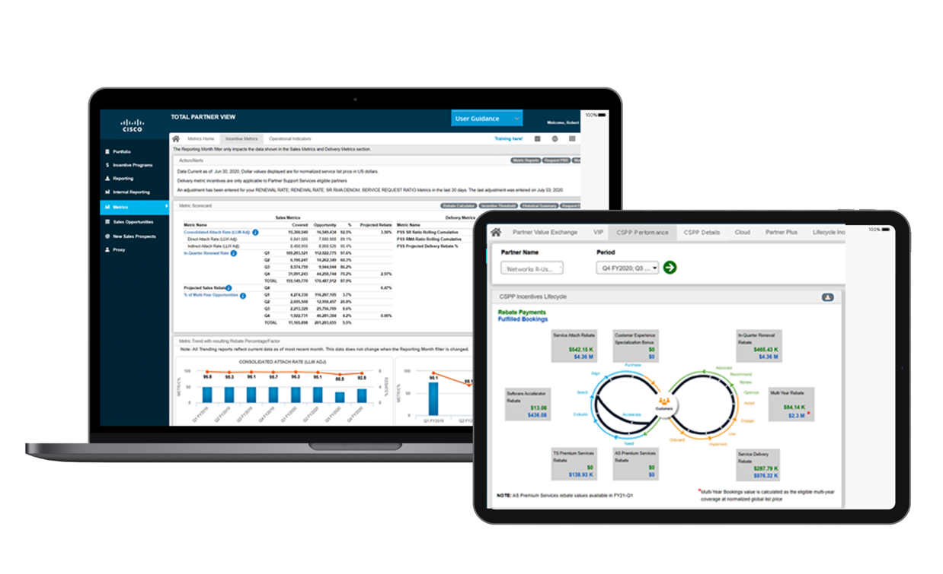
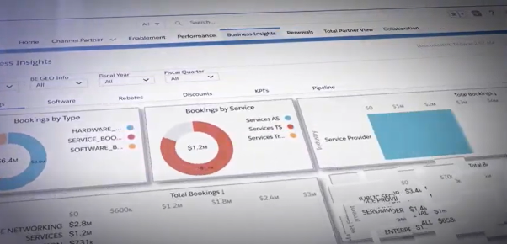
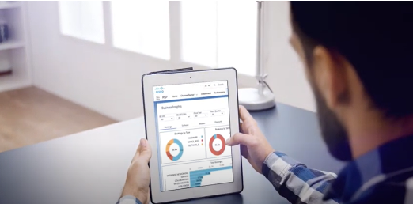
Services portfolio
Renew with Comstor
Maximising business outcomes
Enhancing profitability
Cisco Partner Experience Platform (PXP)
Your one-stop place for everything you need to grow your Cisco business
Faster innovation: better intelligence speeds up your response to change and drives selling and co-selling
Clear path to growth and profitability: you will be able to identify:
    the most promising renewal and upsell opportunities
    the customers with the highest growth potential
    the capabilities your teams need to sell new architectures
Continuous planning: we track performance against
targets in real-time, year-round, and correct course as needed
Connectivity and benchmarking: connect with partners
globally and display your performance compared to your peers
Back to Contents
24

Slide 25

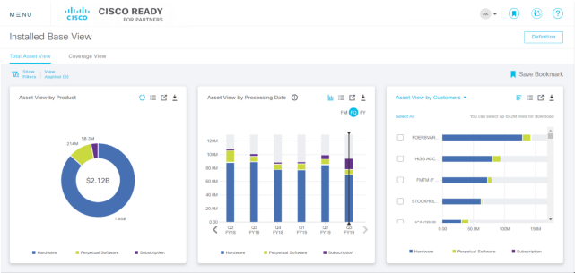
Services portfolio
Renew with Comstor
Maximising business outcomes
Enhancing profitability
Cisco Ready for Partners
Cisco Ready helps understand customers’ install base including hardware, software and service contract details by providing visibility into:
Product Refresh Opportunity
Service Renewal Opportunity
New Service Attach Opportunity
Subscription Renewal Opportunity
Back to Contents
25

Slide 26



Services portfolio
Renew with Comstor
Maximising business outcomes
Enhancing profitability
Comstor Icebreaker
Comstor
Icebreaker
Program
The program for Comstor partners to give full visibility on Cisco solutions status, offering unique opportunities to up-sell and cross-sell based on a personalised “Smart Icebreaker report” that Comstor experts prepare.
New service attach
Renewals
Product refresh
Increased IB visibility results in a secure and compliant network; reducing response times and allowing an efficient troubleshooting
Consolidating and co-terming active contracts, simplifies contract management process and helps budgeting ahead
Identify what devices in the network are obsolete. Ensure the infrastructure is up to date and eligible to new system features
Back to Contents
Fnd out more, clicik here to watch Comstor icebreaker video - https://fast.Wistia.Net/embed/iframe/zu3tpcy6pa
26

Slide 27
Services portfolio
Renew with Comstor
Maximising business outcomes
Enhancing profitability
Lifecycle Advantage
Services related tracks
  Renewals track
  Streamlines the renewal process, increasing partner efficiency, and making the process easier to manage and scale, resulting in increased customer renewals
  Growth track:
  Partners can grow faster and increase revenue by providing additional services, complementary solutions or refresh end-of-life technology
Lifecycle Advantage leverages insights and automation to drive retention and growth by digitally engaging your customers throughout the lifecycle.
The platform helps you engage customers with the right message – whether that’s assisting adoption, simplifying renewals or up-selling to higher value solutions.
  Customer success track
  Helps customers realise the full value of their Cisco solutions while they implement and use the technology
Back to Contents
Notes:
Relook this slide

Slide 28
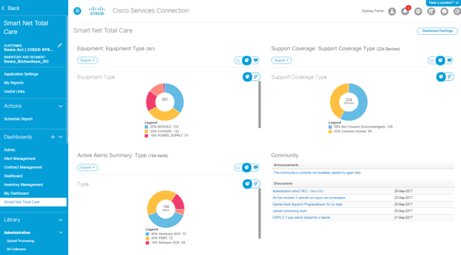
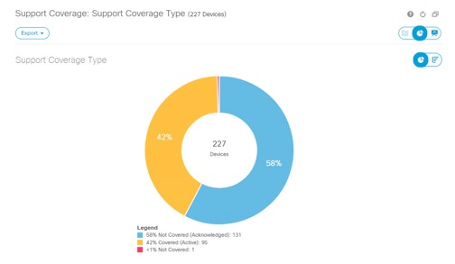
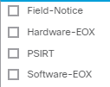
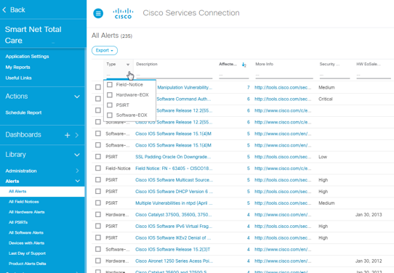
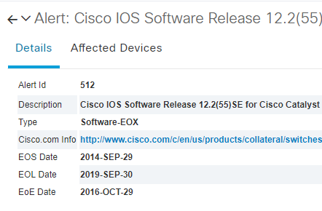
Services portfolio
Renew with Comstor
Maximising business outcomes
Enhancing profitability
Smart Net Total Care Portal
The Cisco Smart Net Total Care portal reduces risk and ensures compliance by providing security and targeted product alerts, last day of support (LDoS) details, and visibility into network device changes.
  Faster problem resolution
  Identify issues quickly through proactive alerts, automated diagnostics, up-to-date contract coverage data, and product information
  Risk mitigation
  Installed-base visibility in the portal helps ensure that your critical Cisco products are covered by the correct service contracts. The portal also makes it easy to proactively plan and budget for technology refresh of the Cisco products that are expected to reach End-of-Life (EoL) or Last Date of Support (LDoS)
  Operational efficiency
  The automated inventory and contract management highlights changes and provides budget and planning foresight in order to minimise the effort that is required to maintain an up-to-date view of your network
Back to Contents

Slide 29

Enhancing profitability with Cisco Services
Back to Contents
29

Slide 30
Services portfolio
Renew with Comstor
Maximising business outcomes
Enhancing profitability
Multiyear services for
the best deal
Up to 35% cost reduction
Cost simulation
Incremental discount benefit of multiyear
$60,000
Enhance your rebate potential
Increase profit margins and bottom lines faster
$50,000
$40,000
$30,000
35%
28%
Reduce admin and operating expenses
Expand the
revenue per
customer
$20,000
$10,000
$0
1
2
3
4
5
Eliminate the impact of list price increases and FX fluctuations
Benefit from
higher discounts and lock in prices
Key:
Annual
Renewals
3 Year Contract + Annual Renewals
5 Year Contract
Back to Contents
30
Notes:
Going back to the beginning when we were talking about busting myths, around multiyear there are also several that must be busted; the one that comes out the most is “Multiyear services are more expensive”. This is actually not true, if we look into the detail, we see that this is in fact cheaper. When we compare the cost of covering a device yearly and how much it would be on a 3-year contract, we see that the total cost can be cut in around 28%, and on a 5-year contract in around 35%, which is not a negligible cost reduction.
This is achieved because multiyear services benefit from incremental discounts. Additionally, you remove the risk of list price changes and FX rate fluctuations. There are many other reasons to go with multiyear services link ensuring continuous service coverage, better manage operating expenses or increase your rebate potential.

Slide 31
Services portfolio
Renew with Comstor
Maximising business outcomes
Enhancing profitability
Cisco Services Partner Program
EEA
MEA
Min Max
Min Max
Attach
Rate
Thresholds
Rebate
75% 95%
1% 10%
60% 80%
1% 8%
Thresholds
Rebate
Min Max
Min Max
In Quarter Renewal
Rate
70% 90%
1% 15%
45% 85%
1% 6%
Thresholds
Rebate
Thresholds
Rebate
Min. Max
Min Max
Multiyear Rebate
30% 90%
1% 9%
30% 90%
1% 3%
Thresholds
Rebate
Thresholds
Rebate
Premium Services Rebate
>45% >65% >85%
1% 2% 3%
Thresholds
Rebate
>65% >75% >85%
1% 2% 3%
Thresholds
Rebate
Back to Contents
31
Notes:
CSPP is a rebate program that rewards partners for their services sales upon achieving certain metrics and thresholds.
As you can see, there are several KPI’s that can help you grow your bottom-line. The most common ones are the service attach rebate and the In-Quarter Renewal Rate rebate. However, the other rebates are incremental rebates for driving specific offerings or solutions.
As example, let’s imagine that you have hit the maximum thresholds on Attach and IQRR. This means that from your fulfilled service bookings you will receive a back end rebate of 14% (8% for your attach rate performance and 6% for your IQRR performance). Now, 30% of your bookings have been multiyear, you will get 1% of the eligible bookings value, on top of the 14% you won for attach and renew.
CSPP can be a very profitable program, we just need to ensure we identify and follow on the eligible opportunities. We can help you maximize your rebates, do not hesitate to contact us for more info.

Slide 32
Services portfolio
Renew with Comstor
Maximising business outcomes
Enhancing profitability
Cisco Services Partner Program
Total Value Rebate
Who’s eligible?
Select level (or above)
How are you paid?
Paid once at the start of the service term
Paid on the Total Contract Value for the quarter for qualifying services
EEA
60% 80%
1% 8%
MEA
12%
6%
Monthly Value Rebate
45% 85%
1% 6%
CX Specialization (BASE)
Advanced CX Specialization
(BONUS)
Who’s eligible?
Customer Experience Specialization
Bonus requires Advanced Customer Experience Specialization
How are you paid?
Each quarter over the life of the service
Paid on the monthly value of qualifying services
30% 90%
1% 3%
3%
1% incremental
Enhanced Management Services Rebate
Program Region | Minimum bookings eligibility |  | Attach Rate % Eligibility October 31, 2021
 | Q2 | Q3
 | October 31, 2021 | January 30, 2022
EEA | $40,000 | $100,000 | ≥ 75%
MEA | $15,00 | $50,0000 | ≥ 60%
3%
Rebate on eligible Enhanced Management Services bookings
>65% >75% >85%
1% 2% 3%
Advanced Services Premium Rebate
3%
Rebate on eligible Business Critical Services bookings
Back to Contents
Notes:
CSPP is a rebate program that rewards partners for their services sales upon achieving certain metrics and thresholds.
As you can see, there are several KPI’s that can help you grow your bottom-line. The most common ones are the service attach rebate and the In-Quarter Renewal Rate rebate. However, the other rebates are incremental rebates for driving specific offerings or solutions.
As example, let’s imagine that you have hit the maximum thresholds on Attach and IQRR. This means that from your fulfilled service bookings you will receive a back end rebate of 14% (8% for your attach rate performance and 6% for your IQRR performance). Now, 30% of your bookings have been multiyear, you will get 1% of the eligible bookings value, on top of the 14% you won for attach and renew.
CSPP can be a very profitable program, we just need to ensure we identify and follow on the eligible opportunities. We can help you maximize your rebates, do not hesitate to contact us for more info.

Slide 33
Services portfolio
Renew with Comstor
Maximising business outcomes
Enhancing profitability
Services promotions
Up to
Up to
100%
DISCOUNT
14%
DISCOUNT
18%
DISCOUNT
Cisco One SWSS to DNA transition
Renewal Promotion aiming to support Cisco One perpetual license migration into Cisco DNA/ACI
Cisco One SWSS benefits are delivered through the DNA & ACI SW subscriptions
Promotion only available for DNA licenses coming from SWSS renewal
3Y Multiyear promotion
Incremental discounts on 3Y to 5Y service deals
Available to Cisco Registered or Certiﬁed Partners ordering through Distribution
Eligible for SNTC, SNTC for UCS and Solution Support
5Y Multiyear promotion
Incremental discount on 5Y service deals
Available to Cisco Registered or Certiﬁed Partners ordering through Distribution
Eligible for SNTC, SNTC for UCS and Solution Support
Back to Contents
33
Notes:
To finalize, I would like to give you a quick snapshot of the available promotions we currently have on services, to help you increase your profitability in every deal. These promos are available until 31st July.
Multiyear promotions for deals going from 3 to 5 years
Incremental discounts on solution support for DNA licenses
And 100% discount on your migration from SWSS to DNA. This promo is only available for DNA licenses coming from a SWSS renewal. It cannot be used for every DNA license.

Slide 34

Services portfolio
Renew with Comstor
Maximising business outcomes
Enhancing profitability
Handling objections
“We will order the services once the warranty expires”
Cisco standard warranty does not provide the same features and capabilities of a Service Contract
LLW warranties are available only on selected Cisco products and do not provide the full range of capabilities that a service contract can provide. For example: LLW offers hardware replacement shipped within 10 business days and does not include TAC support
“I don’t need service; I keep an inventory of spares products”
Sparing rarely saves customers money. To spare effectively requires a large investment in a system, security and in-house experts. Often, these costs exceed the cost of a Cisco service contract
Questions to consider:
What is the cost of a service contract compared to the cost of network downtime?
If cash flow is an issue, Cisco Capital can provide financial options to help customers get the services they need to protect their investment?
Purchasing software updates is more expensive than a services contract?
There might be delays in getting replacement parts, and ultimately the cost of network downtime might be higher
Back to Contents
34

Slide 35

Partner testimonials
“Having Comstor pro-actively quoting for our renewals is great, having them mail us our opportunities every
quarter is just fantastic”
Partner: BSU
"Building a renewal practice is a strategic must do for us and Comstor is guiding us step by step with their expertise"
Partner: Acknowledge
“The renewal business is very time sensitive, Comstor adds value to my business telling exactly when to focus to ensure I don’t miss any renewals”
Partner: Barike
“Comstor’sexpert team are our ideal partner for Cisco Services and renewals. They proactively help us drive
our renewal opportunities ensuring we achieve
our CSPP Metrics”
Partner: Cubit Technologies
"Comstor have a specialised, expert Cisco Services and renewals team; they have helped us drive our renewal rate”
Partner: Ivent Mobile
“Comstor offers an invaluable support system to us when it comes to Cisco Services. Starting from monitoring our client base and keeping an eye on all our clients’ renewals, to closely monitoring our rebates”
Partner: Vision Valley
"Comstor is always willing to go that extra mile for
us, Comstor has proven over many years that they
deliver to very high standards. They are our trusted
and preferred partner"
Partner: Fujisoft
Back to Contents

Slide 36
Thank you
Back to Contents

